Slide 1

Abstract Data Type
ADT

Slide 2
WHAT ARE TREES?
Trees are visual representation of a hierarchical to show how data is organized.
They are often used in many different ways in computer systems, such as the way folders are structured on your drive or cloud storage.
Binary Tree
A Binary Tree is tree data structure consist of nodes which are points in the tree.
Nodes can have a maximum of 1 link to a parent node(a node above) and a maximum of 2 links down to children nodes(nodes below).
Each element in the binary tree can have only 2 children, we typically name them the left and right child.

Slide 3
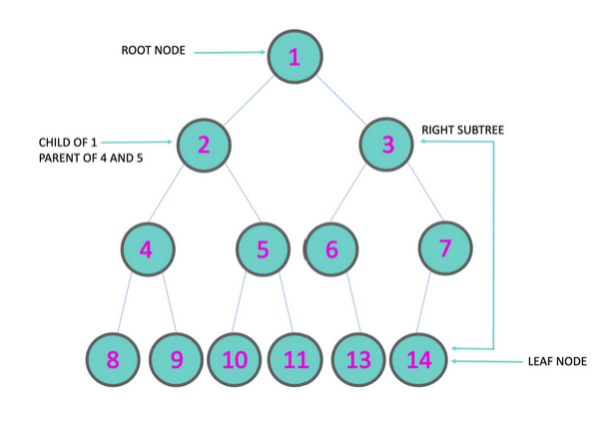
Parts to the Binary Tree
ROOT: The node at the top of the tree
PARENT: Any node that has a child node below
LEFT-CHILD: The node on the left below a parent
RIGHT-CHILD: The node on the right below a parent
SUBTREE: A branch to the left or right of a parent that has at least one child of its own.
​LEAF: The last nodes at the bottom of the tree

Slide 4

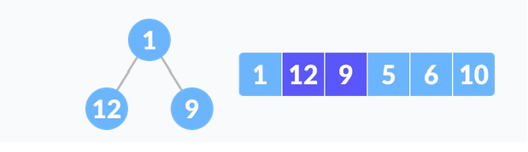
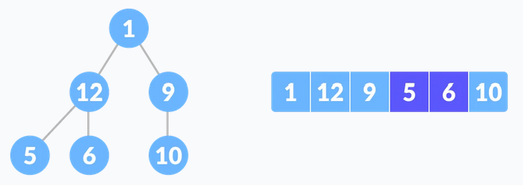
Creating a Binary tree
Select the first element of the list to be the root node.
Put the second element as a left child of the root node (the insert node is larger than the root it goes to the left)
Put the third element as a right child of the root node (the insert node is smaller than the root it goes to the left)
Continue until all the notes are inserted

Slide 5
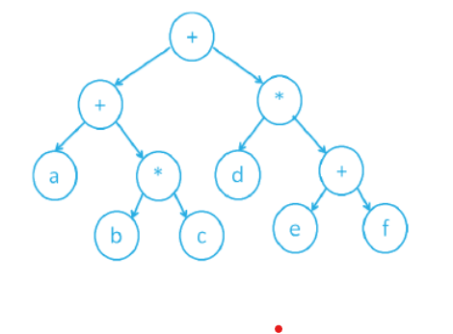
Creating a tree structure
a + (b * c) + d * (e + f)

Slide 6
Basic Operation of a Binary Tree
Deletion for an element.
Traversing an element. There are four (mainly three) types of traversals in a binary tree
Inserting an element.
Removing an element.
Searching for an element.

Slide 7
Title Slide 6

